Slide 1

A Water-Flow Analogy for Teaching Data Reuse and Memory Hierarchies
Tanvi Sharma
Kaushik Roy
06/21/25

Slide 2
Overview
Motivation
Lowering the barrier to entry for AI hardware in one lecture for undergraduates
Emphasis on the impact of data reuse on performance
Outline
Examples of AI workloads
A simple memory-compute model for AI hardware
Introduction to water-flow analogy
Memory- and compute- bound scenarios to understand data reuse
Relation with roofline performance model
Latency-bound scenario and implications
Conclusion

Slide 3
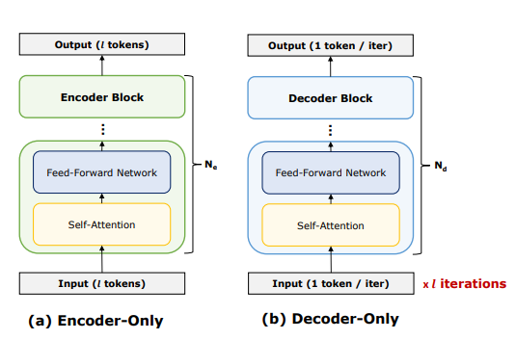
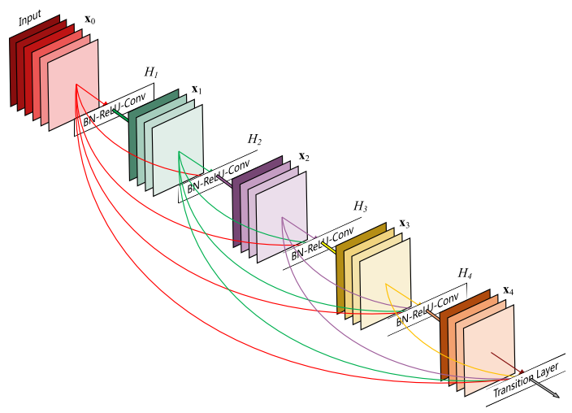
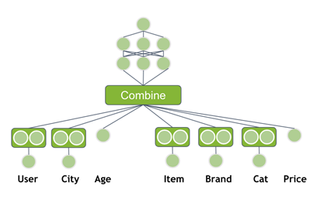
Artificial Intelligence (AI) Workloads
Transformer models
Convolutional Neural Networks (CNNs)
Recommendation Systems (RecSys)
(FFNs)
(FFNs)
Full Stack Optimization of Transformer Inference, 2023
ResNet Depiction
RecSys, Nvidia Blog
Artificial Intelligence (AI) is used everywhere in day-to-day applications such as chat-bots, text autocompletion, ad recommendations, summarization tasks and image recognition.
AI model architectures – Transformers (most common these days), CNNs, FFNs, RecSys, etc.

Slide 4
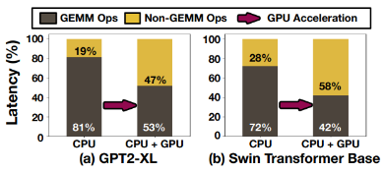
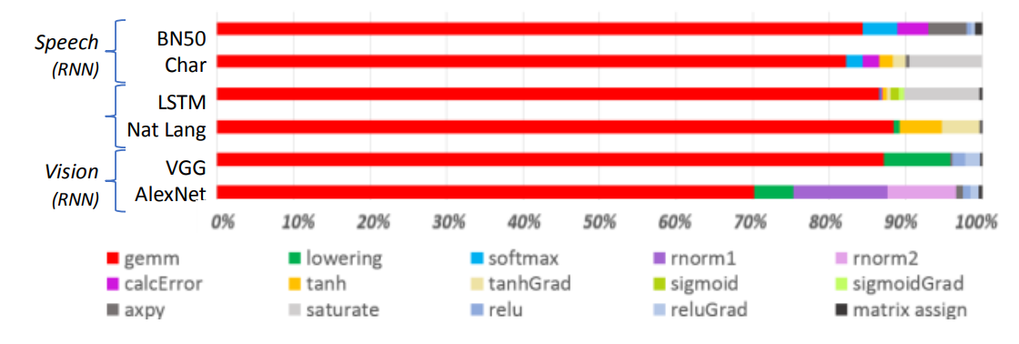
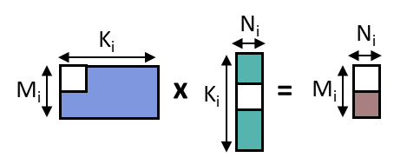
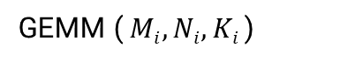
Dominant Computation in AI workloads
BERT-Large Latency % with sequence length
RNN Runtime Distribution
Softermax. DAC 2021.
NonGEMMBench. ISPASS 2025
Approximate Computing AI Acceleration. IBM Blog 2018.
Most AI workloads are dominated by GEMMs (GEneral Matrix Multiplications).
GEMMs are represented as GEMM(M, N, K).
AI hardware is designed to maximize performance of GEMMs.
GEMM ($Mi, Ni, Ki$)

Slide 5
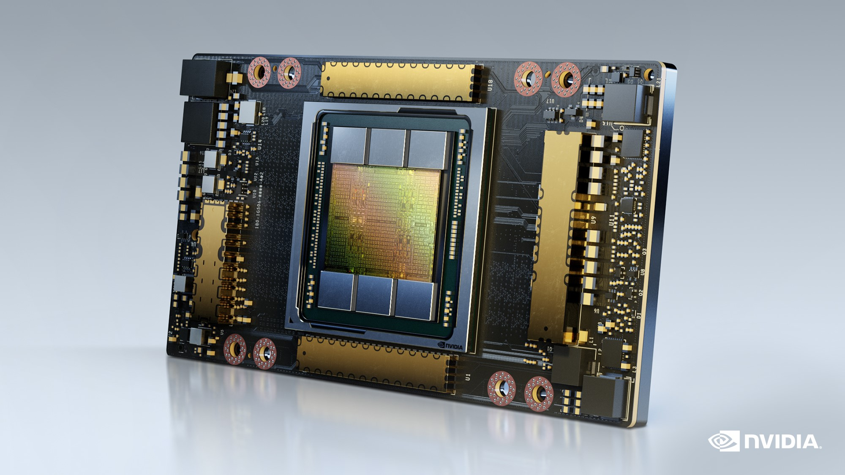
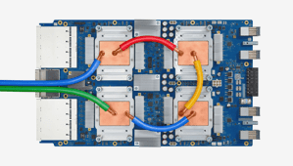


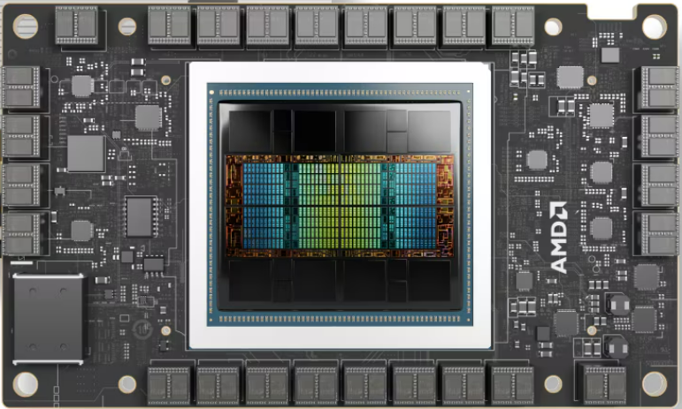
Common Examples of AI Hardware
Graphics Processing Units (GPUs) – started as domain specific ICs for accelerating graphics, now general-purpose programmable IC.
Tensor Processing Units (TPUs) – Domain specific IC specially designed for AI processing.
Neural Processing Units (NPUs) – Application Specific IC designed for one end system.
What do they have in common?

Slide 6
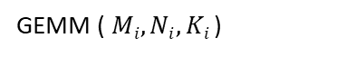
Simple Memory-Compute Model for AI Hardware
K_{i}
N_{i}
N_{i}
Compute
x
=
Off-chip Memory
M_{i}
K_{i}
M_{i}
On-chip Memory
GEMM ($Mi, Ni, Ki$)
A simple analytical model of AI hardware consists of
- off-chip memory (say DRAM or HBM)
- on-chip memory (SRAM)
- some compute units (ALUs or SIMD or Systolic Arrays)
Focus of this lecture - understand how data reuse in GEMMs impacts the hardware performance through a water-analogy.

Slide 7






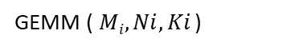
Waterflow-Analogy for Simple Memory-Compute Model
K_{i}
N_{i}
N_{i}
Compute
x
=
Off-chip Memory
M_{i}
K_{i}
M_{i}
On-chip Memory
Water – Data (bytes)
Rate of doing dishes – Performance (operations/sec)
GEMM ($Mi, Ni, Ki$)
Tank – Off-chip memory
Bucket – On-chip memory
Dishes – DNN operations, GEMMs
Tap – Memory Controller
You – Compute

Slide 8
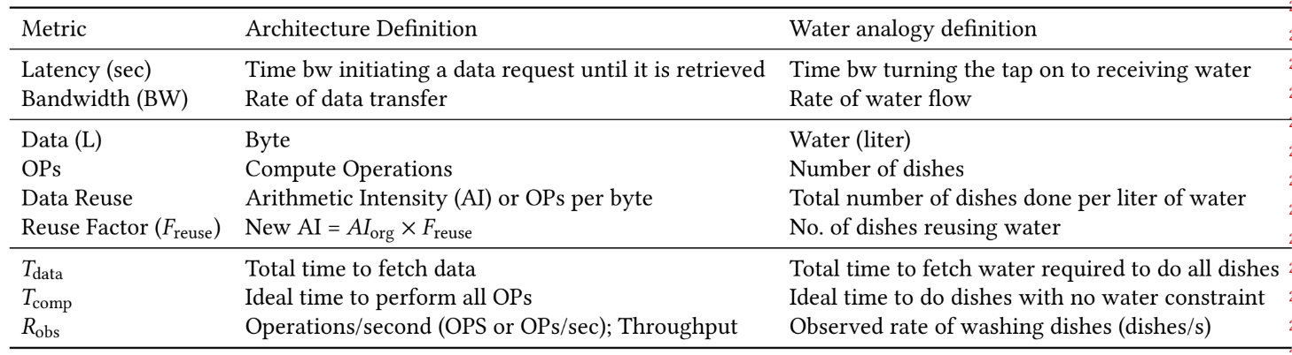
Waterflow-Analogy for Simple Memory-Compute Model
Tank – Off-chip memory
Bucket – On-chip memory
Dishes – DNN operations, GEMMs
Tap – Memory Controller
You – Compute
Given the number of DNN operations and limited BW constraint, how to maximize R_{obs}?

Slide 9

Waterflow-Analogy Model Illustration (1) 9
Latency = 0.1 sec
Case 1: Reuse factor (F_{reuse}) = 1 OPs = 10 Data (required)
= 2 *10 / F_{reuse}
= 20 L T_{data} = L + Data/BW
= 0.1 + 20/1 = 20.1 sec
T_{comp} = Data/R_{peak}
= 20/4 = 5 sec R_{obs} = 10/(20.1 + 0.5) OPS
= 0.485 OPS
Assuming each dish requires 2L of water,
Peak rate (R_{peak}) = 2 OPS * 2 L/op
= 4 L/sec
Say, Ops = 100.
How can we improve the performance? Does rate-matching memory bandwidth and compute throughput help?
Memory Controller
BW = 1L/sec
Peak rate = 2 OPS
2.1sec/OP
Compute
GEMMs
0.5 sec/OP
time

Slide 10
Waterflow-Analogy Model Illustration (2) 9
Latency = 0.1 sec
Case 2: Reuse factor (F_{reuse}) = 1 OPs = 100 Data (effective) = 200 L
Data (required) = 2 *100 / F_{reuse}
= 200 L T_{data} = max(T_{tap} , T_{bucket})
= max(200.1, 200/4) = 200.1 sec
T_{comp} = Data/R_{peak}
= 50 sec R_{obs} = 100/200.6 OPS = 0.50 OPS
or dropping the tail latency,
R_{obs} = 100/200.1 OPS = 0.50 OPS
Memory Controller
Assuming each dish requires 2L of water,
Peak rate = 2 OPS * 2 L/op
= 4 L/sec
BW = 1 L/sec
On-chip SRAM
Caches are useful only if there are data reuse opportunities.
BW = 4 L/sec
Peak rate = 2 OPS
…
time
Compute
GEMMs
Water Analogy with caches/bucket

Slide 11
Impact of Data Reuse on Performance (1) 9
Latency = 0.1 sec
Case 3: Reuse factor (F_{reuse}) = 2 OPs = 100
Data (effective) = 200L Data (required)
= 2 *100 / F_{reuse}
= 100 L T_{data} = max(T_{tap} , T_{bucket})
= max(100.1, 200/4) = 100.1 sec
T_{comp} = Data/R_{peak}
= 200/4 = 50 sec (T_{tap} >> T_{comp}) R_{obs} = 100/100.1 OPS
= 0.99 OPS
Memory Controller
Assuming each dish requires 2L of water,
Peak rate = 2 OPS * 2 L/op
= 4 L/sec
BW = 1 L/sec
Considering some dishes are not heavily soiled – can share same water for cleaning. 2L effectively acts as 4L for you.
On-chip SRAM
BW = 4 L/sec
Peak rate = 2 OPS
…
Memory bound
Compute
GEMMs
(a) Water Analogy with caches/bucket
time

Slide 12
Impact of Data Reuse on Performance (2) 9
Latency = 0.1 sec
Case 3: Reuse factor (F_{reuse}) = 4 OPs = 100
Data (effective) = 200L Data (required)
= 2 *100 / F_{reuse}
= 50 L T_{data} = max(T_{tap} , T_{bucket})
= max(50.1, 200/4) = 50.1 sec
T_{comp} = Data/R_{peak}
= 200/4 = 50 sec (T_{tap} ~ T_{comp}) R_{obs} = 100/50.1 OPS ~ 2 OPS (R_{peak})
Memory Controller
Assuming each dish requires 2L of water,
Peak rate = 2 OPS * 2 L/op
= 4 L/sec
Considering dishes are soiled only slightly – more dishes can share same water for cleaning. 2L effectively acts as 8L for you.
BW = 1 L/sec
On-chip SRAM
BW = 4 L/sec
Peak rate = 2 OPS
…
Compute
GEMMs
Balanced
(a) Water Analogy with caches/bucket
time

Slide 13
Impact of Data Reuse on Performance (3) 9
Latency = 0.1 sec
Case 3: Reuse factor (F_{reuse}) = 8 OPs = 100
Data (effective) = 200L Data (required)
= 2 *100 / F_{reuse}
= 25 L T_{data} = max(T_{tap} , T_{bucket})
= max(25.1, 200/4) = 50 sec
T_{comp} = Data/R_{peak}
= 200/4 = 50 sec (T_{tap} < T_{comp}) R_{obs} = 100/50 OPS = 2 OPS (R_{peak})
Memory Controller
Assuming each dish requires 2L of water,
Peak rate = 2 OPS * 2 L/op
= 4 L/sec
BW = 1 L/sec
Say some notorious kid have put already clean dishes in the sink – more water reuse. 2L effectively acts as 16L for you.
On-chip SRAM
BW = 4 L/sec
Peak rate = 2 OPS
…
…
Compute
GEMMs
Compute bound
(a) Water Analogy with caches/bucket
time

Slide 14
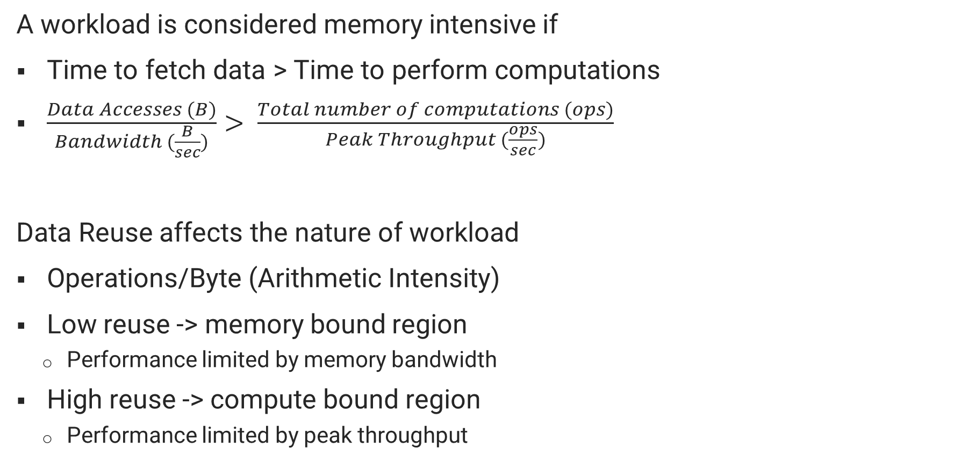
Roofline: Memory vs Compute intensive
A workload is considered memory intensive if
Time to fetch data > Time to perform computations
$\frac{Data Accesses (B)}{Bandwidth (\frac{B}{sec})}> \frac{Total number of computations (ops)}{Peak Throughput (\frac{ops}{sec})}$
Data Reuse affects the nature of workload
Operations/Byte (Arithmetic Intensity)
Low reuse -> memory bound region
Performance limited by memory bandwidth
High reuse -> compute bound region
Performance limited by peak throughput
Roofline Performance Model
Peak Throughput (OPS)
Observed Throughput
(OPS)
Bandwidth (B/s)
Memory bound
Compute bound
Data Reuse (Ops/B)
Williams, Samuel Webb, Andrew Waterman, and David A. Patterson. Roofline: An insightful visual performance model for floating-point programs and multicore architectures. Vol. 1. Technical Report UCB/EECS-2008-134. 2008.
Notes:
Now if we try to plot data reuse along the x axis

Slide 15
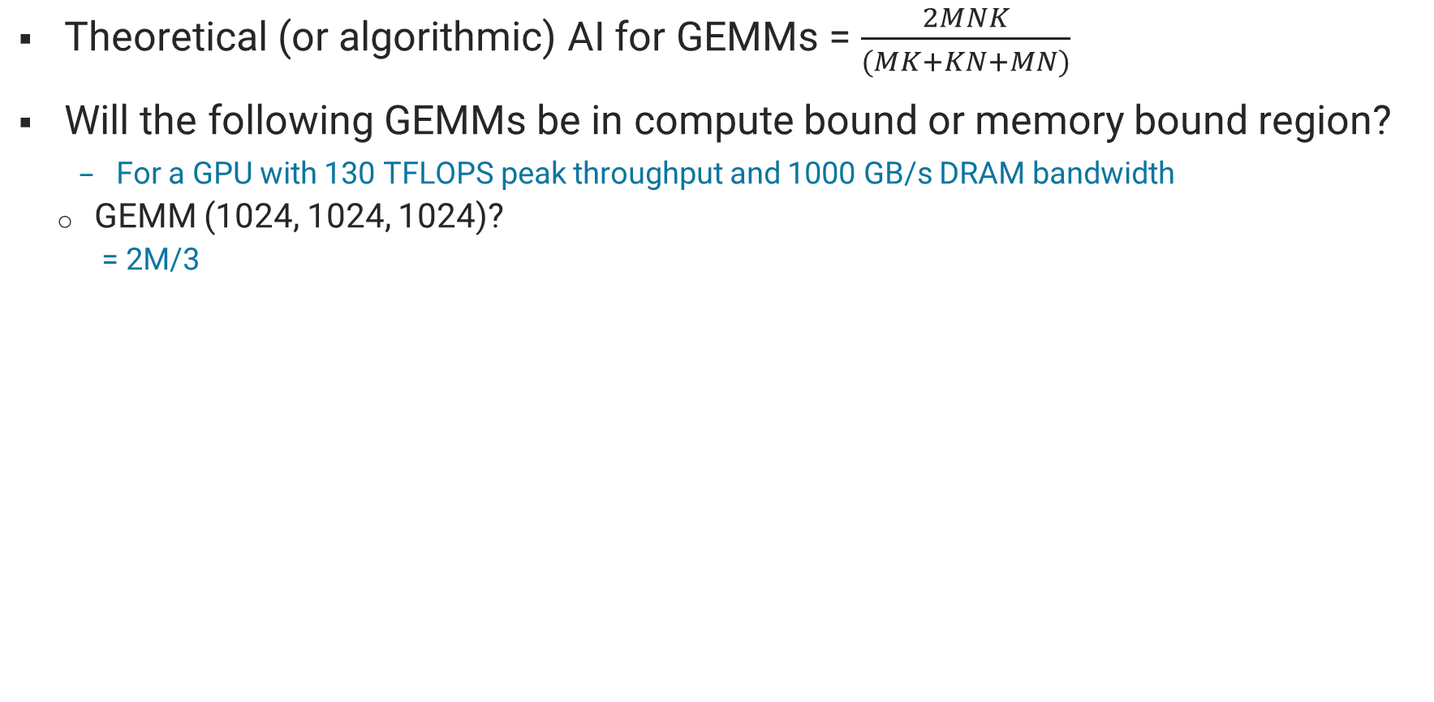
Arithmetic Intensity of GEMMs (1)
Theoretical (or algorithmic) AI for GEMMs = $\frac{2MNK}{(MK+KN+MN)}$
Will the following GEMMs be in compute bound or memory bound region?
For a GPU with 130 TFLOPS peak throughput and 1000 GB/s DRAM bandwidth
GEMM (1024, 1024, 1024)?
= 2M/3
C
K
N
N
…
…
…
=
K
M
A
M
x
B

Slide 16
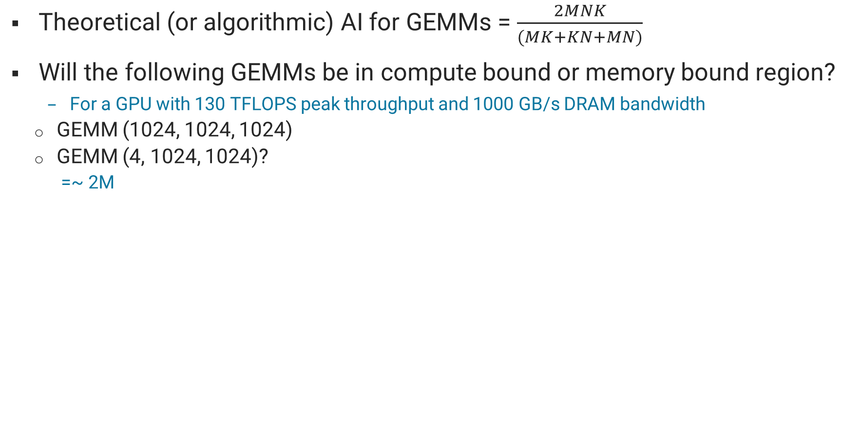
Arithmetic Intensity of GEMMs (2)
Theoretical (or algorithmic) AI for GEMMs = $\frac{2MNK}{(MK+KN+MN)}$
Will the following GEMMs be in compute bound or memory bound region?
For a GPU with 130 TFLOPS peak throughput and 1000 GB/s DRAM bandwidth
GEMM (1024, 1024, 1024)
GEMM (4, 1024, 1024)?
=~ 2M
C
K
N
N
M
M
…
…
…
=
K
A
x
B

Slide 17
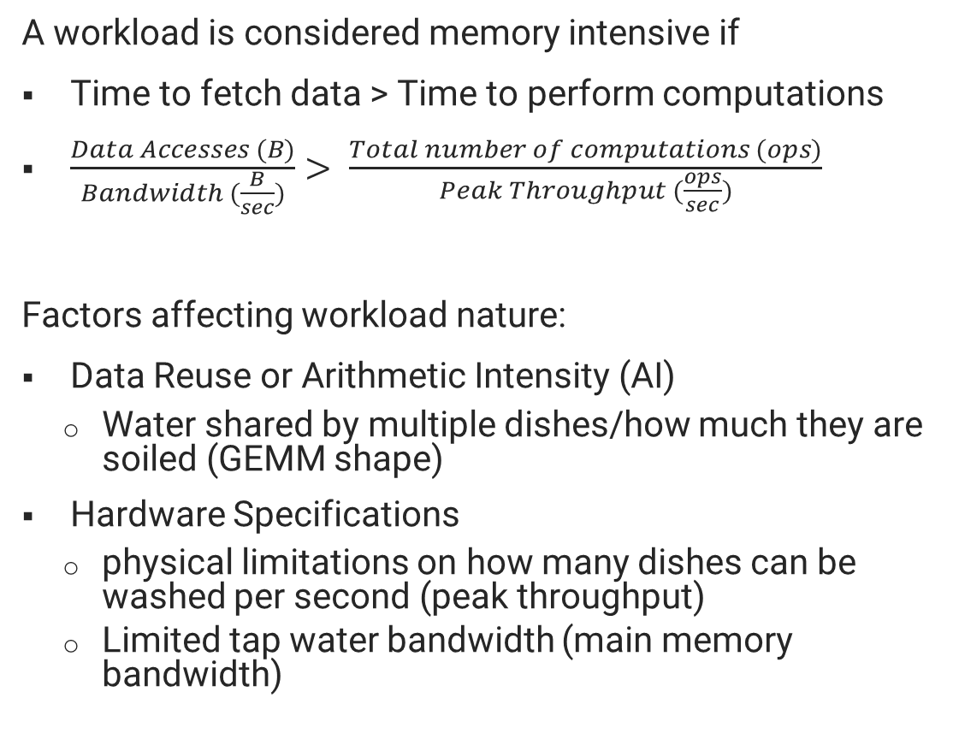
Roofline: Memory vs Compute intensive
A workload is considered memory intensive if
Time to fetch data > Time to perform computations
$\frac{Data Accesses (B)}{Bandwidth (\frac{B}{sec})}> \frac{Total number of computations (ops)}{Peak Throughput (\frac{ops}{sec})}$
Factors affecting workload nature:
Data Reuse or Arithmetic Intensity (AI)
Water shared by multiple dishes/how much they are soiled (GEMM shape)
Hardware Specifications
physical limitations on how many dishes can be washed per second (peak throughput)
Limited tap water bandwidth (main memory bandwidth)
Peak = 2 OPS
Observed Throughput
(OPS)
1 L/s
Ridge Point AI = 2
Memory bound
Compute bound
AI or Data Reuse (Ops/L)
AI or Data reuse = (1 Op/2 L)*F_{reuse}
Ridge Point AI = 2 OPS/1 L/s = 2 Ridge Point F_{reuse} = 2/(1/2) = 4
Is it always necessary for a workload to be either in the memory bandwidth- or compute- bound region?
Notes:
Now if we try to plot data reuse along the x axis

Slide 18
Examples of Memory-bound Scenarios
Latency = 1 sec
Assuming each dish requires 2L of water,
Peak rate = 200 OPS * 2 L/op
= 400 L/sec
Case 6: Reuse factor (F_{reuse}) = 1 OPs = 1000
Data (effective) = 2000 L Data (required)
= 2 *1000 / F_{reuse}
= 2000 L T_{data} = max(T_{tap} , T_{bucket})
= max(1+2000/10, 2000/400) = 201 sec
T_{comp} = Data/R_{peak}
= 2000/400
= 5 sec
(T_{data} >> T_{comp}) R_{obs} = 1000/201 OPS
= 4.98 OPS << 200 OPS
Case 7: Reuse factor (F_{reuse}) = 4 OPs = 4
Data (effective) = 8 L Data (required)
= 2 *4 / F_{reuse}
= 2 L T_{data} = max(T_{tap} , T_{bucket})
= max(1+2/10, 8/400) = 1.2 sec
T_{comp} = Data/R_{peak}
= 8/400
= 0.02 sec
(T_{data} >> T_{comp}) R_{obs} = 4/1.2 OPS
= 3.33 OPS << 200 OPS
Memory Controller
BW = 10 L/sec
On-chip SRAM
BW = 400 L/sec
Peak rate = 200 OPS
(a) Memory-bandwidth bound
(b) Memory-Latency bound
Compute
GEMMs

Slide 19
Conclusion
Proposed a simple waterflow-analogy for showcasing the impact of data reuse on AI hardware performance.
Connected the concepts to the roofline performance model with worked-out examples.
Used in the first offering of AI Hardware course at Purdue – where students were from different backgrounds (from pure algorithm to circuit designers).
The given slides can be used prior to introducing dataflow or scheduling strategies, lowering the barrier to AI hardware concepts.

Slide 20

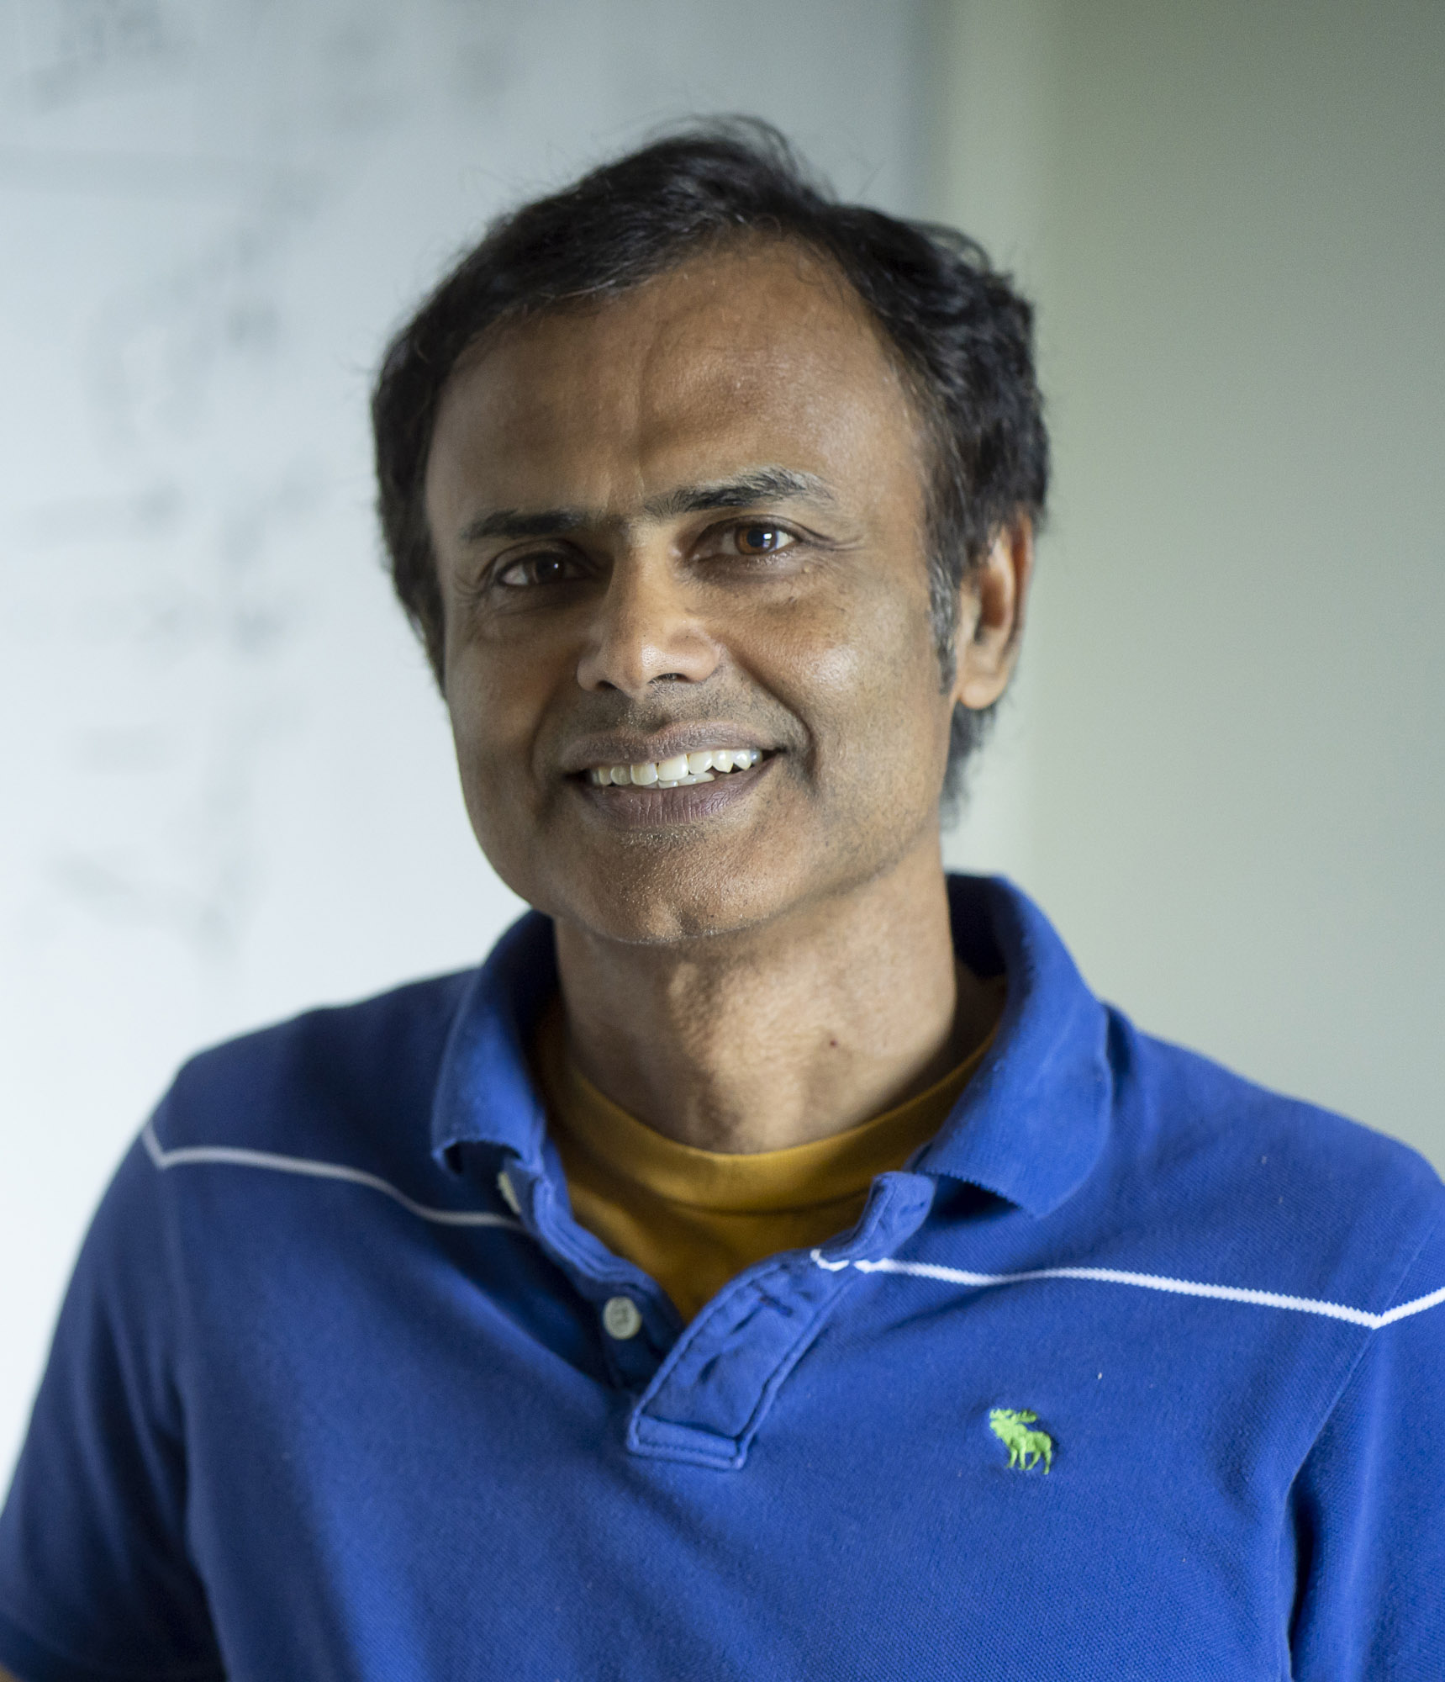
Q&A
Thank you. Any feedback?

Slide 21
Appendix

Slide 22
Recap: Evaluating DNNs
Simple memory-compute model
Arithmetic Intensity (data reuse)
Roofline performance model
Memory bound region
Compute bound region
Question:
For a GPU with 130 TFLOPS peak throughput and 1000 GB/s DRAM bandwidth, what will be the minimum value of arithmetic intensity for it to be compute bound?
(transition AI)
Compute
Off-chip Memory
On-chip Memory

Slide 23
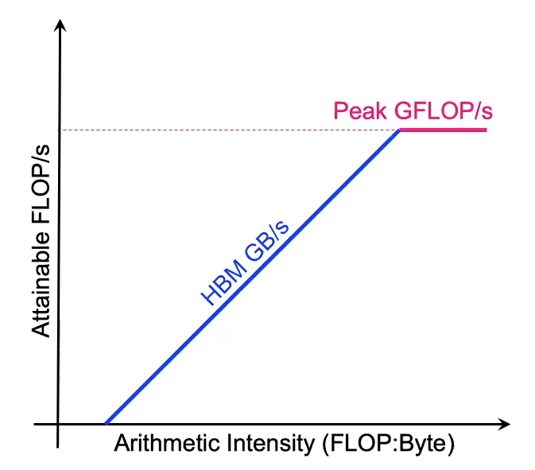
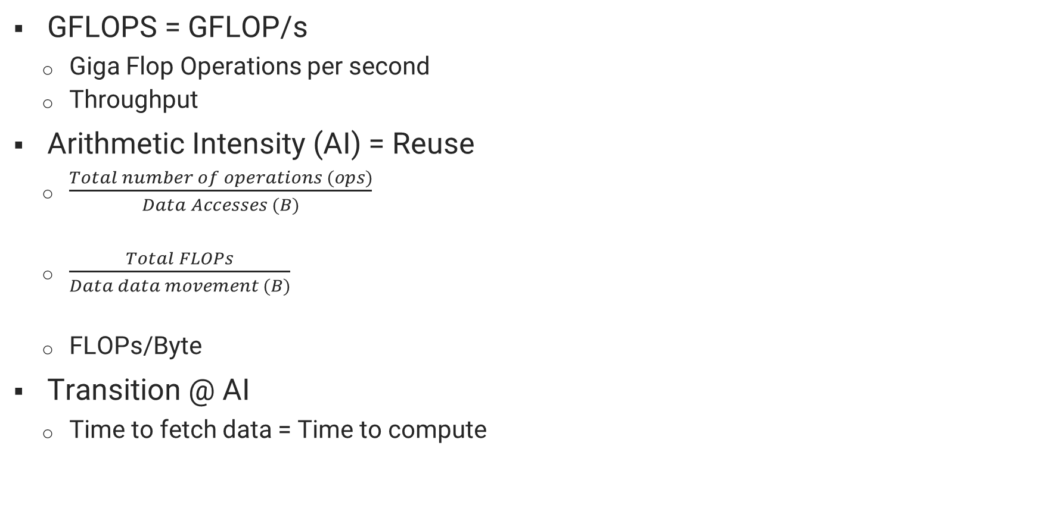
Recap: Roofline Performance Model
GFLOPS = GFLOP/s
Giga Flop Operations per second
Throughput
Arithmetic Intensity (AI) = Reuse
$\frac{Total number of operations (ops)}{Data Accesses (B)}$
$\frac{Total FLOPs}{Data data movement (B)}$
FLOPs/Byte
Transition @ AI
Time to fetch data = Time to compute
Transition @ AI = Peak GFLOPs/Peak GB/s
Notes:
now as Adi asked in the last class, what does this throughput and data reuse mean in terms of neural networks?

Slide 24
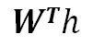
Recap: Matrix Multiplications in DNN Models (1)
For a layer in MLP with
Input dimension – din
Output dimension – dout
Pytorch: nn.Linear
N
N
din
din
$$WTh$$
x
=
dout
(matmul)
dout
N
N
Weights
Activation
Output
Notes:
remember that neural networks can be thought of as matrix multiplications for MLPs

Slide 25
Recap: Matrix Multiplications in DNN Models (2)
For a convolution layer with
Filter size – R x S x C
Input fmap size – H x W x C
Output fmap size – P x Q x K
Batch size – N
Implicit GEMM algorithm using im2col transformation
(GEMM – general matrix multiplication)
RSC
K
K
x
=
RSC
NPQ
NPQ
Activation
Weights
Output
Notes:
CNNs

Slide 26
Recap: Matrix Multiplications in DNN Models (3)
For an attention layer with
sequence length – n
embedding dimension – d_{k (=v=q)}
heads = h
Static matrix multiplications – Q, K, V, Output
Dynamic matrix multiplications – QK^{T}, QK^{T}V
e.g.
d_{k}/h
n
n
x
=
d_{k} /h
n
n
Q
K^{T}
QK^{T}
Notes:
even in attention layers

Slide 27
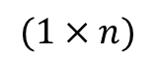
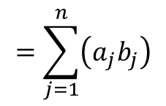
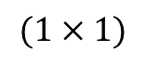
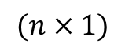
Basic Computations in AI Workloads
Dot Product (a . b = a^{T}b = c)
Product is a scalar value
Vectors typically treated as column vectors
Used to measure similarity, also referred as inner product
a1
a2
.
.
.
.
an
b1
b2
.
.
.
.
bn
a1 | a2 |  |  |  |  | an
b1
b2
.
.
.
.
bn
c
.
x
$$=\sum_{j=1}^{n}{\left(a_{j}b_{j}\right)}$$
=
a
b
$$(1×n)$$
$$(n×1)$$
$$(1×1)$$
Number of operations?
MAC (multiply and accumulate)

Slide 28
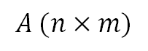
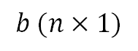
Basic Computations in AI Workloads
Matrix Vector Multiplication (A^{T}b = c)
Product is a vector
Each element in output vector is dot product of row of A^{T} and the vector b
a₁₁ | a₁₂ | . | a_{1m}
a₂₁ | a₂₂ | . | .
. | . | . | .
. |  | . | .
.
.
a_{n1} | a_{n2} | . | a_{nm}
b1
b2
.
.
.
.
bn
$$A (n×m)$$
$$b (n×1)$$
Notes:
Each output is a dot product between the row of input matrix and the other vector

Slide 29
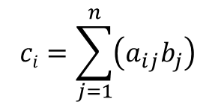
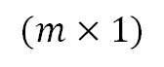
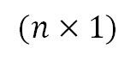
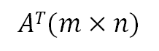
Basic Computations in AI Workloads
Matrix Vector Multiplication (A^{T}b = c)
Product is a vector
Each element in output vector is dot product of row of A and the vector b
b1
b2
.
.
.
.
bn
c1
c2
.
.
cm
a₁₁ | a₂₁ | . | . | . | . | a_{n1}
a₁₂ | a₂₂ | . | . | . | . | a_{n2}
. | . | . | . | . | . | .
a_{1m} | a_{2m} | . | . | . | . | a_{nm}
$$ci=\sum_{j=1}^{n}{\left(a_{ij}b_{j}\right)}$$
x
=
$$AT(m×n)$$
$$(n×1)$$
$$(m×1)$$
Notes:
Each output is a dot product between the row of input matrix and the other vector

